Slide 1
Generating Networks with a Given Global Structure Using Local (Sub)Structures
SUNBELT
Marjan Cugmas with prof. Anuška Ferligoj and prof. aleš žiberna
BEIJING, 2017
Notes:
Good morning! My names is Marjan Cugmas and I am from the Faculty of Social Sciences, University of Ljubljana. In this talk I will present some results on generating the networks with a given global structure using local substructures. The work was done together with professor Anuška Ferligoj and professor Aleš Žiberna.

Slide 2
Background
how to generate networks with a given global structure, based on different types of triads
to understand the factors that drive the network to a certain global structure
Example: In a new emerging organization one would like to encourage the employs to collaborate in a way that would result in a given structure (e.g., cohesive or hierarchical) in order to increase productivity.
Notes:
Imagine a new emerging organization or a class of young students which meet for the first time. In order to increase the productivity, one would like to encourage the employees or the students to collaborate in a certain way. To achieve this, he or she can promote or restrict some kind of collaborations in the organization or in a class.
In this talk, I will address the question on how to generate the networks with a given global structure, based on different types of triads. This could help us to understand which which types of collaborations have to be omitted and which encouraged in a certain company or in a class to achieve a desired collaboration patterns among employees or students.

Slide 3
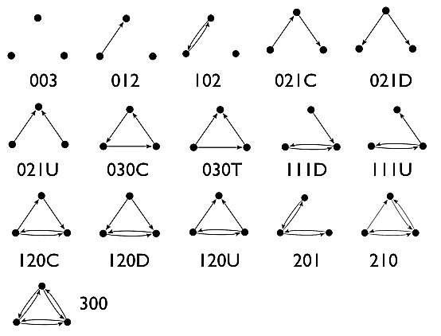
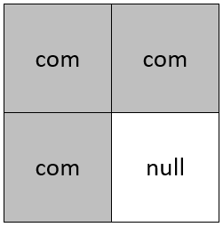
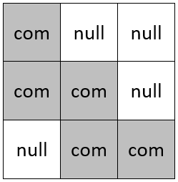
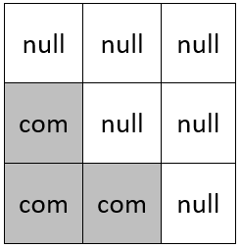
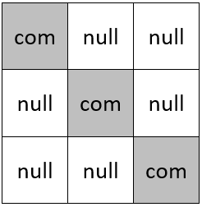
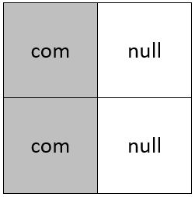
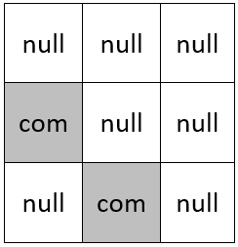
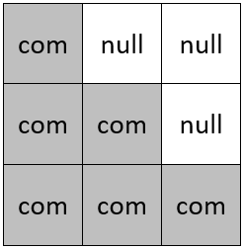
Local and global network structures
LOCAL NETWORK STRCUTURES DIFFERENT TYPES OF TRIADS | GLOBAL NETWORK STRUCUTRES DIFFERENT TYPES OF BLOCKMODELS
Very often studied as micro structures in different macro structures. 16 different types. Yet, only 15 of them will be considered in this study to avoid multicolinearity. | A blockmodel is a network where the units are clusters (positions) of (structurally) equivalent units from the studied network. The term block refers to the ties between two clusters (positions).
Notes:
The different types of triads which are often studied as micro structures in different macro structures. They are just of the right size to be used to define different social network mechanisms. There are 16 types of triads but to avoid the multicolinearity, the triad type 003 will not be considered in this study.
On the other hand, the global network structures are defined by different types of blockmodels. A blockmodel is a network where the units are clusters (sometimes called positions) of structurally equivalent units. The term block refers to a submatrix showing the ties between two clusters. The cohesive, core-periphery, hierarchical and transitivity types of blockmodels of the most common. Let us take a closer look to them.

Slide 4
Different types of blockmodels
symmetric core-periphery
hierarchical with complete blocks on the diagonal
transitivity with complete blocks on the diagonal
cohesive
asymmetric core-periphery
hierarchical without complete blocks on the diagonal
transitivity without complete blocks on the diagonal
Notes:
The first one is the cohesive blockmodel. Here we assume several positions of units which are all linked to each other inside the position. Furthermore, the units from different positions are not linked to each other.
In the case of symmetric core-periphery blockmodel with two positions, there is one core position consisting of internally highly linked units and one peripheral position of units. The units in the periphery are not linked to each other. The peripheral units are linked to the core one and the core one are linked to the peripheral ones in the symmetric case while in the asymmetric case, only the peripheral units are linked to the core ones.
Let us assume that there are three clusters of units. If the network has a hierarchical blockmodel structure, the units from one cluster are linked to the units from another cluster of units which are further linked to units from another cluster … You can see, that the clusters of units are ordered hierarchically. In the case of a hierarchical structure with complete blocks on the diagonal, the units within clusters are well linked to each other but in the case of a hierarchical blockmodel without complete blocks on the diagonal, the units within the clusters are not linked to each other.
Transitivity types of blockmodels are similar to hierarchical ones, but here, also links from the units from the lowest position to the units from the top position exist.

Slide 5
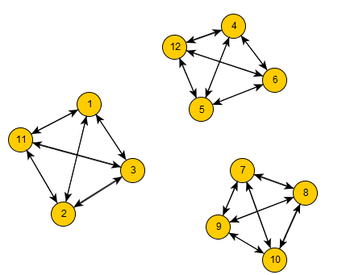
The triads and blockmodels
According to different types of blockmodels, the triads can be classified to two sets:
allowed types of triads (the number of this types of triads is greater than zero in an ideal blockmodel);
forbidden types of triads (the number of this types of triads equals zero in the case of an ideal blockmodel).
EXAMPLE FOR COHESIVE BLOCKMODEL
a network with cohesive blockmodel (with three groups)
the set of allowed types of triads
Notes:
For each type of blockmodel, different types of triads can be classified into the set of allowed and into the set of forbidden types of triads. The allowed types of triads are those of which the number is greater than zero in the case of a network without errors and the forbidden types of triads are those which can not occur in the case of an ideal blockmodel.
For example, in the case of a cohesive blockmodel with three positions, three types of triads are allowed. The first is complete subgraph of size thee which can occur only within positions. The second one is a subgraph of size three with one mutual link. This subgraph can be found only in the case when two units are taken from one position and the third unit is taken from the other position. The third is a subgraph without any link. Such subgraph can be found in the case when each unit is taken from different positions. In the case when only two cores are present, the number of such subgraphs is equal to zero. However, when generating networks, this types of subgraphs are not considered in order to avoid multicolinearity.

Slide 6
The triads and blockmodels
According to different types of blockmodels, the triads can be classified to two sets:
allowed types of triads (the number of this types of triads is greater than zero in an ideal blockmodel);
forbidden types of triads (the number of this types of triads equals zero in the case of an ideal blockmodel).
 | allowed triad types for considered types of blockmodels
 | 300 | 210 | 201 | 120U | 120D | 120C | 111U | 111D | 303T | 030C | 021U | 021D | 021C | 102 | 012 | 003*
cohesive | • |  |  |  |  |  |  |  |  |  |  |  |  | • |  | •
asymmetric core-periphery | • |  |  |  |  |  |  |  |  |  | • | • |  |  |  | •
symmetric core-periphery | • |  | • |  |  |  |  |  |  |  |  |  |  |  |  | •
hierarchy without complete blocks on the diagonal |  |  |  |  |  |  |  |  |  |  | • | • | • |  |  | •
hierarchy with complete blocks on the diagonal | • |  |  | • | • |  |  |  |  |  |  |  | • | •
transitivity without complete blocks on the diagonal |  |  |  |  |  |  |  |  | • |  | • | • |  |  |  | •
transitivity with complete blocks on the diagonal | • |  |  |  | •
*not considered in the network generating process
Notes:
By counting the number of different types of triads, we made the same classifications for each blockmodel type.
Focusing on the table, you can see that different types of blockmodels are listed in rows while different types of triads are listed in columns. The dots denotes allowed types of triads for a specific blockmodel type. All the others are forbidden in the case of an ideal blockmodel. Two important features can be recognized based on this table. The first is that most of triads are forbidden in all analyzed blockmodel types and the second one is that one can differentiate between all types of blockmodels by considering only the number of a few of triad types. As mentioned, the latter is true for the networks without errors only.

Slide 7
Generating Networks With a Given Blockmodel
To study the impact of different mechanisms on the global network structure, the following algorithms are used in this study:
the Relocation of Links algorithm;
the MCMC algorithm (from Exponential Random Graph Modeling).
Both algorithms assume that :
the network is small so each unit knows the links between all the other units;
the change of a link by the unit is goal-oriented.
Notes:
To generate the networks with a given blockmodel, considering different types of triads, we used two algorithms. The first is called the Relocation of links algorithm and the second is the Monte Carlo Multi Chain algorithm implemented in ergm R package.
Both algorithms assume that the network is small enough, therefore each unit knows the links of all the others. The change of a link status is goal-oriented. Both of assumptions are satisfied in many analyzed social-networks.

Slide 8
Generating networks with RL algorithm
determine the distribution of the local network statistics for the case of the network with an ideal blockmodel structure
generate a random network with the number of links as in the case of the network with an ideal blockmodel structure
determine the distribution of the local network statistics on a random network
repeat many times on a random network
randomly select a link and a non-link
transform selected link to a non-link and vice versa
determine the distribution of the local network statistics
calculate the improvement in the distribution of the local network statistics
if the distribution is closer to an ideal one, keep the relocated link
Notes:
The first algorithm is rather simple. First, the network with the perfect blockmodel structure is generated and used to obtain the chosen local network statistics. A random network is taken as an initial network. Then, the iterative procedure is applied. During this, on each step, a randomly selected link is relocated if this improves the distribution of a selected local network statistics. Here, the selected network statistics are the number of different considered types of triads. The iterative procedure stops when a certain number of iterations, defined by the user, is reached. In this study, this is after 25,000 iterations.
Randomly selected link is therefore relocated on a randomly selected place in the network if this reduce the difference in the number of considered triad types between the considered network and an ideal network.

Slide 9
To be careful
This approach is seen as very deterministic (the link is allocated only if the distribution of triads of proposed network is closer to the distribution of triads in the case of the network with an ideal blockmodel structure);
The risk of local optimum exists (could be avoided by some further improvements of the algorithm);
Computationally very intensive algorithm (higher number of iterations is needed in the case of denser networks).
Notes:
The described algorithm is deterministic since there is no probability assigned on the relocation of a link. Instead, the link is relocated always if this improves the distribution of considered types of triads. Also, there is a high risk of local optimum which could be, to some extend, avoided by considering some further improvements of the algorithm.
Also, the algorithm is computationally very intensive. Especially in the case of denser networks, there is a small probability that the best links will be randomly chosen and relocated on a randomly chosen location.

Slide 10
Generating networks with the MCMC algorithm
The distribution of $Y$ can be parameterized in the form: $$P_{θ,𝒴}\left(Y=y\right)=\frac{exp⁡\{θ^{T}g(y)\}}{κ(θ,𝒴)}, y∈𝒴$$ where $θ$ is the vector of model coefficients and $g(y)$ is a $q$-vector of statistics based on the adjacency matrix $y$. The denominator is the normalizing factor that ensures that the above expression is a probability distribution.
start from random network $𝒴$
until the approximate converge of $P_{θ,Y_{0}}(Y=y)$ is reached
randomly choose a pair $\left(i,j\right)$
calculate the $P_{θ,𝒴}\left(Y_{ij}=0|Y_{ij}^{c}=y_{ij}^{c}\right)$ and $P_{θ,𝒴}\left(Y_{ij}=1|Y_{ij}^{c}=y_{ij}^{c}\right)$
set $Y_{ij}$ to 0 or 1 according to above conditional probabilities
Notes:
The MCMC algorithm is based on an Exponential Random Graph Model which enables to calculate the probability for establishing or dissolving a certain link. Once the model is stated, the iterative algorithm is applied on a random network. At each step, the randomly selected link or non-link is established or dissolved with a certain probability according to the parameters’ values. The algorithm stops when the convergence is reached.

Slide 11
To be careful
One have to select the ERGM coefficients (in a current study, all the parameters’ values are set to 2 (allowed types of triads) or -2 (forbidden types of triads));
the density can be considered as being fixed or variable.
The risk of almost full or almost empty generated network exists (could be avoided by carefully selected types of triads and/or by setting the number of links fixed).
Notes:
Here, two main disadvantages can be highlighted.
The first is that one have to estimate the model’s parameters which can be challenging and rather unpractical in some cases. In this study, all the parameters’ values are set arbitrary. If a certain type of triads is forbidden, then their parameter value is set to -2, otherwise to +2. The density is considered as fixed although this is not very realistic in the case of many social networks since the density is usually affected by some social network mechanisms.
Another common problem which can occur when using ERGM models is the degenerativity which is reflected through generated networks which are almost empty or almost full. This can be avoided by carefully selected terms.

Slide 12
Simulation
REPEAT 50 TIMES
A RANDOM NETWORK IS GENERATED
THE RL ALGORITM OR MCMC ALGORITHM IS APPLIED ON RANDOM NETWORK
THE PRE-SPECIFIED BLOCKMODELING IS APPLIED ON BOTH NETWORKS
THE VALUE OF A CRITERION FUNCTION IS CALCULATED FOR BOTH NETWORKS
CALCULATE THE MEAN IMPROVEMENT VALUE AS
$$MIV=mean\left(\frac{P_{r}−P_{m}}{P_{r}}\right)∗100$$
where $P_{r}$ are the values of the criterion function corresponding to random networks and $P_{m}$ are the values of the criterion function corresponding to generated networks.
Notes:
What can we see on this slide is the whole simulation design. As such it was applied for each studied blockmodel type and the whole procedure were repeated 50 times.
The procedure is as follows: first, we generate a random network. Then, the RL algorithm and the MCMC algorithm are applied on this random network. Here, all possible types of triads are considered in the first setting and only the subsets of forbidden types of triads are considered in the second setting.
On both, the initial random network and the model generated network the pre-specified blockmodeling was applied and the value of the criterion function was calculated. The criterion function is defined as the difference between the expected ideal structure and the empirical blockmodel structure. Lower values are desired.
On all 50 generated networks for each blockmodel type, the mean improvement value was calculated. The MIV is an indicator of how close to the ideal is the global network structure after one or the other algorithm is applied where the reference is the random network. The value of 100 means that the generated networks are ideal networks with a selected blockmodel.

Slide 13
Mean improvement values
Notes:
The mean improvement values are shown on this graph to different types of blockmodels. The lines are showing the MIV for each combination of triad types and algorithm. The red lines corresponding to the RL algorithm wile the green ones denotes the MIV corresponding to MCMC algorithm.
It can be seen, in general, that the MIV are higher in the case of the RL algorithm. The exception is only the symmetric core-periphery blockmodel where the MCMC algorithm performs much better, according to the MIV.
For practical reasons, we are especially interested in generating networks considering only the list of forbidden types of triads. In this case, the number of different types of triads does not have to be provided. Within each algorithm, the MIV are generally lower when the set of forbidden types of triads is considered. But, it has to be emphasized that the MIV are not so much lower. In some cases, for example in the case of symmetric core-periphery blockmodel generated by the RL algorithm, the MIV is the highest when considering the set of forbidden types of triads.
Based on the MIV one can conclude that the easiest to generate are asymmetric core-periphery blockmodel and transitivity type of blockmodels while the hardest to generate are both types of hierarchical blockmodels. Symmetric core-periphery blockmodel is hard to generate by the RL algorithm but relatively good results are obtained using the MCMC algorithm.
Now, let us take a look at some examples of generated networks.

Slide 14
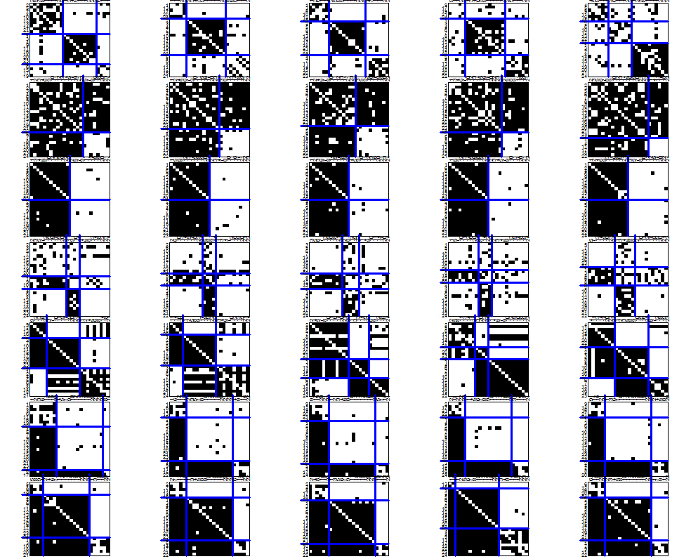
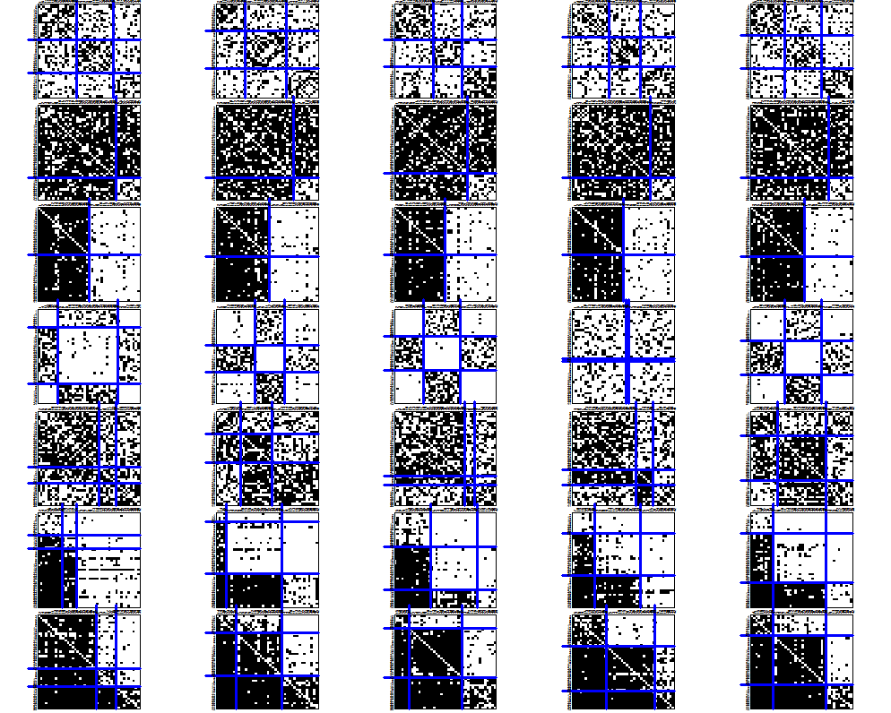
Generated networks
IDEAL
RELOCATION OF LINKS ALGORITHM
MCMC ALGORITHM
Notes:
On the left side, there are five generated networks with the relocation of links algorithm for each blockmodel type. Similarly, five networks are generated for each blockmodel type using the MCMC algorithm.
In general, it can be seen that the sizes of positions are less equal in the case when the RL algorithm is used. For example, in the case of transitivity blockmodel with complete blocks on the diagonal, the second position is the biggest one.
Especially interesting is the hierarchical blockmodel without complete blocks on the diagonal. While the expected structure is partially achieved when using the RL algorithm, the structure is not as expected when the MCMC algorithm is used.

Slide 15
Hierarchical blockmodel without complete blocks on the diagonal
The resulting structures are hierarchical but with asymmetric links from the lower to the upper positions.
To omit such links, the paths of length three can be added to the triads.
To force the three positions to emerge, the parameter value for the triads of type 021D has to be increased.
Notes:
Instead, the structure reminds us to the expected hierarchical one, but with asymmetric links between the units from different positions. Since this is reflected by many paths of length three, this type of links can be omitted by considering the paths of length three.
After this, the networks with transitivity blockmodels without complete blocks on the diagonal or the hierarchical blockmodels with only two groups are produced. To promote the hierarchical structure with three groups, the value of the parameter corresponding to the triad of type 021D has to be increased.
The generated networks in such a way have the expected hierarchical structure with very low level of errors. Similar result, by considering the paths of length three, can be obtained using the RL algorithm.

Slide 16
Take away
The networks with given blockmodels are generated started by random networks.
Most of the studied blockmodel types can be generated considering different triad types (the RL algorithm is more deterministic but the produced networks are closer to the ideal ones, compared to the MCMC algorithm).
Considering some additional local network characteristics can substantially improve the generated blockmodel which was shown on the example of a hierarchical blockmodel where the paths of length three were further considered.
Notes:
The general motivation to study how to generate networks with a given blockmodel, considering only different types of triads, was to find out which types of links among students or employees have to be restricted or promoted in to reach a certain global network structure. We focused on different types of triads since they can be used to operationalize different sociological mechanisms.
It has been shown that considering only forbidden types of triads is enough to produce the networks with most of the blockmodels. However, the hierarchical blockmodel without complete blocks on the diagonal is rather unclear. Here, some other local networks structures has to be considered, such as different types of paths.

